Slide 1
Churn Prediction
Dataset: Telecom Customer Churn Dataset
Techniques Used: EDA, Feature Engineering, Machine Learning & Deep Learning
Objective: Predict customer churn and identify key influencing factors

Slide 2

Problem Statement
Customer churn refers to customers discontinuing a service. In the telecom industry, high churn rates lead to significant revenue loss.
The objective of this project is to:
Predict whether a customer will churn
Identify patterns and factors contributing to churn
Help businesses take proactive retention measures
This is a binary classification problem, where:
1 → Churn 0 → Not Churn

Slide 3
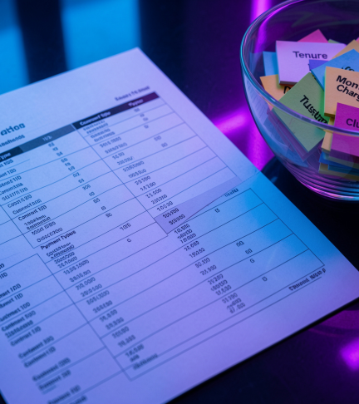
Dataset Overview
The dataset contains detailed information about telecom customers.
Total records: ~7,043 customers
Features include:
Demographic information (Age, Gender, Dependents)
Service usage (Internet, Streaming, Support services)
Billing details (Monthly Charges, Total Charges)
Customer tenure
Additionally, Zip Code Population data was merged to enhance analysis.

Slide 4

Data Preprocessing
The dataset was cleaned and prepared for modeling through the following steps:
Removal of irrelevant columns such as Customer ID.
Handling of missing values using appropriate techniques.
Conversion of categorical variables into numerical format using encoding.
Ensuring all features are suitable for machine learning models.
This resulted in a structured dataset ready for analysis and modeling.

Slide 5

Exploratory Data Analysis (EDA)
EDA was performed to understand customer behavior and identify churn patterns.
Key observations:
Average Age ≈ 49.7 years
Average Tenure ≈ 17 months
Customers who churn:
Have shorter tenure
Have fewer referrals
Have fewer dependents
Insight: Customers with lower engagement and shorter tenure are more likely to churn.

Slide 6

Service-Based Analysis
Customer churn varies significantly based on services used.
Higher churn observed in:
TV Streaming
Movie Streaming
Unlimited Data
Lower churn observed in:
Online Security
Online Backup
Device Protection
Premium Tech Support
Music Streaming
Insight: Value-added services such as security and support reduce churn probability.

Slide 7
Feature Engineering
New features were created to improve model performance:
Uses_High_Churn_Services (Customers using services associated with higher churn)
Uses_Low_Churn_Services (Customers using services associated with lower churn)
Feature engineering helped in:
Capturing meaningful patterns.
Reducing noise.
Improving predictive performance of models.

Slide 8

Machine Learning Models
Multiple machine learning models were implemented and evaluated:
Logistic Regression → 94.88%
Decision Tree → 92.47%
Random Forest → 94.96%
XGBoost → 96.6% (Best ML Model)
Observation:
XGBoost achieved the highest accuracy among machine learning models.
Random Forest provided balanced and stable performance.
Logistic Regression performed well with similar accuracy.
Decision Tree showed comparatively lower performance.

Slide 9
Deep Learning Model
Architecture:
Input layer with customer feature inputs
Hidden Layer 1 → 64 neurons with ReLU activation
Dropout Layer → 0.3 (to reduce overfitting)
Hidden Layer 2 → 32 neurons with ReLU activation
Dropout Layer → 0.2
Output Layer → 1 neuron with Sigmoid activation
Training Configuration:
Epochs: 50 (with Early Stopping)
Batch Size: 32
Optimizer: Adam
Loss Function: Binary Crossentropy
Observation: The ANN model achieved high accuracy and strong recall in churn prediction. The model effectively learned customer behavior patterns and successfully identified most churn customers. The use of ReLU activation, dropout layers, and early stopping helped improve performance while reducing overfitting.

Slide 10
Conclusions
Random Forest achieved strong performance (~94.96% accuracy) with stable predictions.
ANN showed excellent performance (~97.4%) with improved churn detection (higher recall).
XGBoost also performed very well (~96.6%), providing highly precise predictions.
✔ Final Model Selected: ANN
Comparison Insights:
1. ANN performs better in detecting churn customers (higher recall).
2. XGBoost performs better in precision (fewer false positives).
3. Random Forest provides stable but slightly lower performance.
Business Insights:
A. Customers with low tenure are more likely to churn.
B. Service usage patterns strongly influence churn behavior.
C. Retention strategies should focus on high-risk customers.
Final Statement: Although XGBoost provides high precision, ANN is selected as the final model due to its higher accuracy and better recall, making it more effective in identifying churn customers.

